Slide 1

Team Details
Team name: Zenithh
Team leader name: Madhura .M .R
Problem Statement: The Growing Crisis of E-Waste: The rapid pace of technological advancement, coupled with increasing demand for consumer electronics and shorter device lifespans, has led to a dramatic rise in electronic waste (e-waste). According to the Global E-waste Monitor 2020, the world is projected to generate 74 million metric tons of e-waste by 2030. E-waste contains harmful substances and chemicals, contributing to toxic landfills and posing serious risks to public health and the environment. With the integration of artificial intelligence and the demand for advanced hardware like CPUs, GPUs, and memory chips, the e-waste problem is expected to worsen.

Slide 2

AI-Powered E-Waste Management at Your Fingertips
Our smartphone app makes e-waste disposal effortless with: ✅ AI Image Recognition → Instantly identifies & categorizes e-waste ✅ Smart Chatbot Support → Provides real-time recycling guidance ✅ Geolocation Services → Finds nearby collection centers ✅ Gamification & Rewards → Encourages responsible disposal
Key Features:
📷 Scan & Identify → Detects devices like phones, laptops, and batteries 📍 Locate Recycling Facilities → Uses Google Maps API for easy drop-off 💬 AI Chatbot Assistance → Powered by Gemini API for disposal insights 🎮 Earn Rewards → Get points for eco-friendly actions
Impact & Scalability:
🌍 Reduces illegal waste dumping ♻️ Promotes responsible recycling 🤝 Enables partnerships with private & public collectors 📡 Scales across cities with expanding recycling networks
Recycling made simple, smart & rewarding! 🚀♻️

Slide 3
Our Unique Edge
⭐ AI-Powered Waste Identification → Instant classification with deep learning ⭐ Smart Chatbot Assistance → Real-time disposal guidance via Gemini API ⭐ Seamless Geo-Mapping → Quick access to nearby e-waste facilities ⭐ Gamified Engagement → Earn rewards, discounts, and points for recycling ⭐ Scalable & Cloud-Enabled → Expands effortlessly across cities & partners
We make e-waste recycling smarter, easier, and more rewarding!
How We Solve the Problem
🔹 Lack of knowledge? 🤔 → AI chatbot provides instant disposal guidance 🔹 Where to recycle? 📍 → Google Maps API finds nearby recycling centers 🔹 No motivation? 🎁 → Gamification & rewards drive eco-friendly actions 🔹 Waste identification? 📷 → AI-powered scanner simplifies the process
We make ethical e-waste disposal easy, engaging, and rewarding by automating waste detection and connecting users to verified recycling partners!
What Makes Us Stand Out?
Most e-waste apps fall short by providing static info, requiring manual waste selection, or lacking engagement and automation.
🚀 Our AI-driven solution changes the game: ✅ Instant waste identification via image recognition ✅ Smart chatbot for personalized eco-friendly tips ✅ Real-time geolocation for nearby disposal sites ✅ Gamification & rewards to keep users engaged
We make e-waste disposal effortless, educational, and rewarding!

Slide 4
Smart Facility Locator Google Maps integration shows verified recycling centers with live pickup tracking
AI E-Waste Scanner Mobile camera scan (CNN/TFLite) identifies e-waste and suggests disposal methods
Multilingual Eco-Chatbot GPT-4/Gemini-powered assistant provides disposal guides, eco-swaps, and center locations in Indian languages
Green Rewards System Points redeemable for discounts + competitive leaderboards to encourage participation
Doorstep Pickup Integration Scheduled collections with local recyclers + real-time status updates
Impact Dashboard Tracks disposed waste, CO₂ reduction, and reward earnings with visual analytics
Scalable Cloud API Flask/FastAPI backend enables city-wide expansion with secure processing

Slide 5
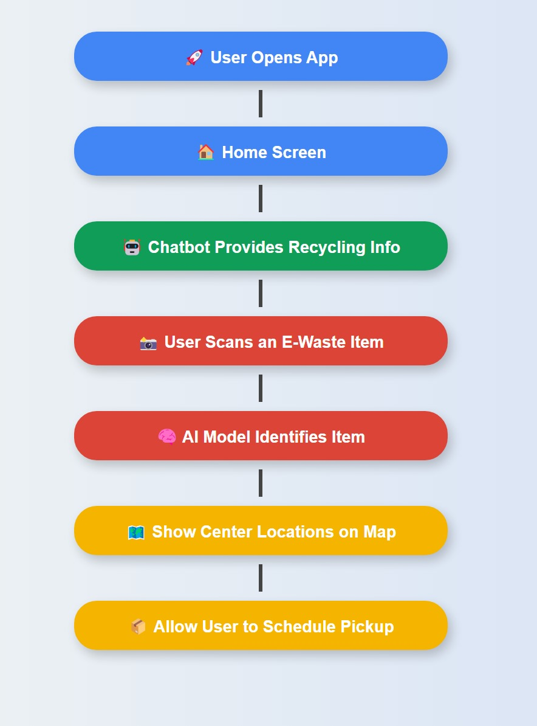
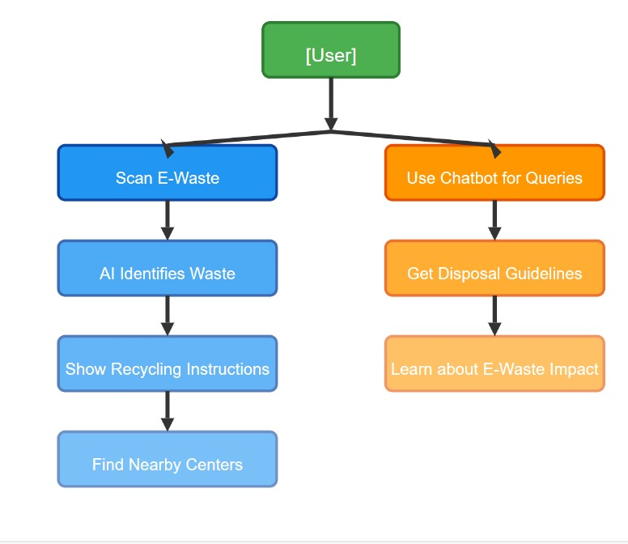
Process flow diagram or Use-case diagram

Slide 6
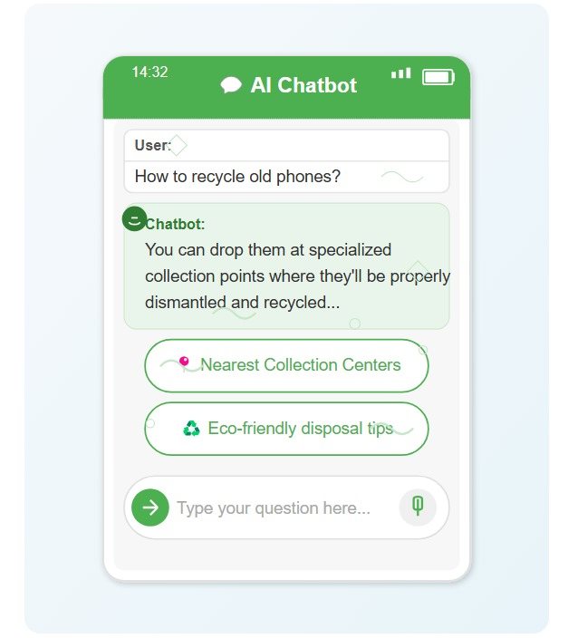
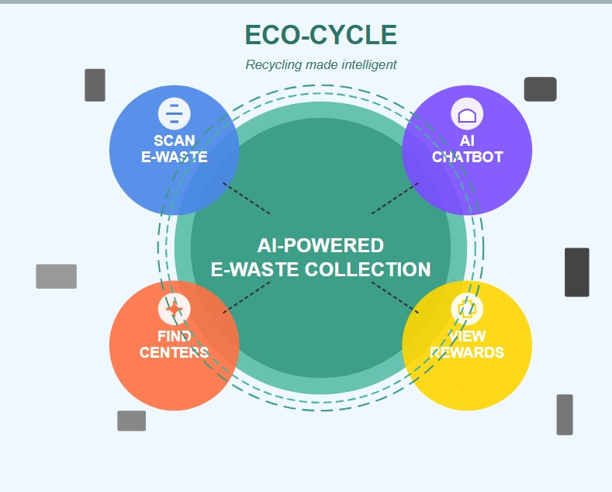
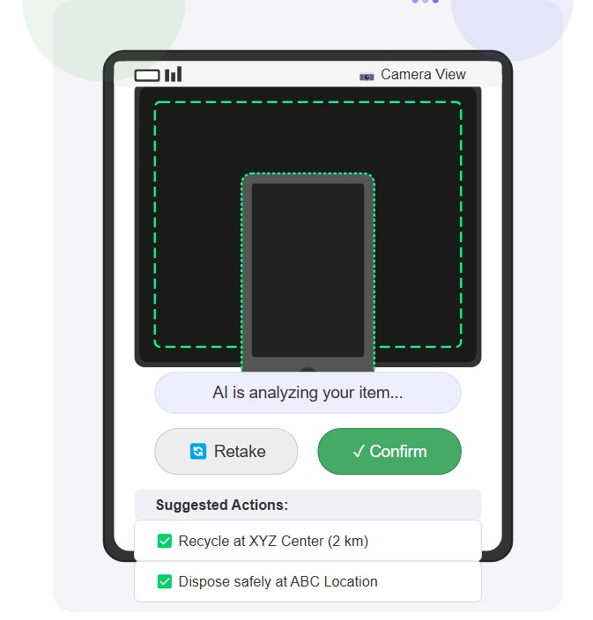
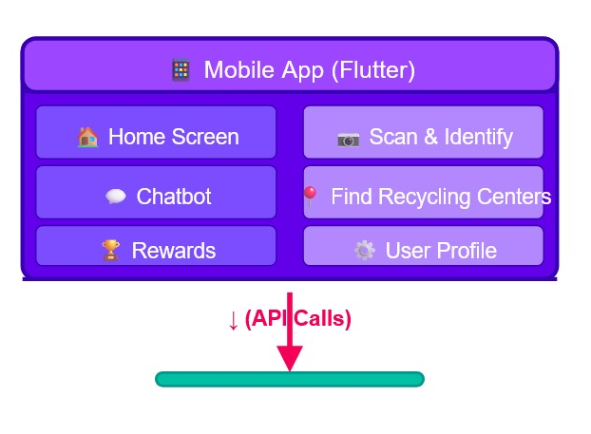
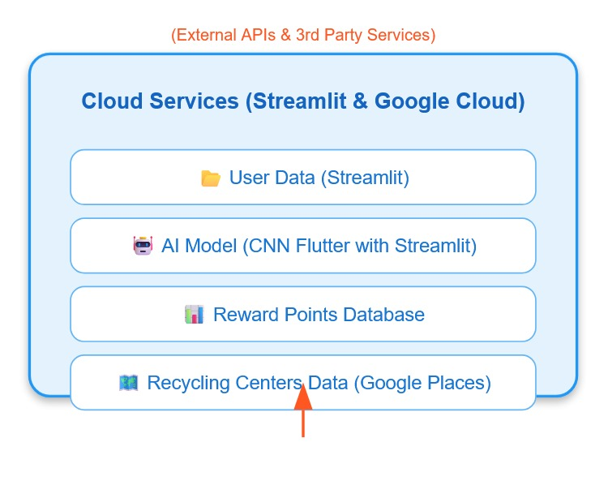
Wireframes/Mock diagrams of the proposed solution (optional)

Slide 7
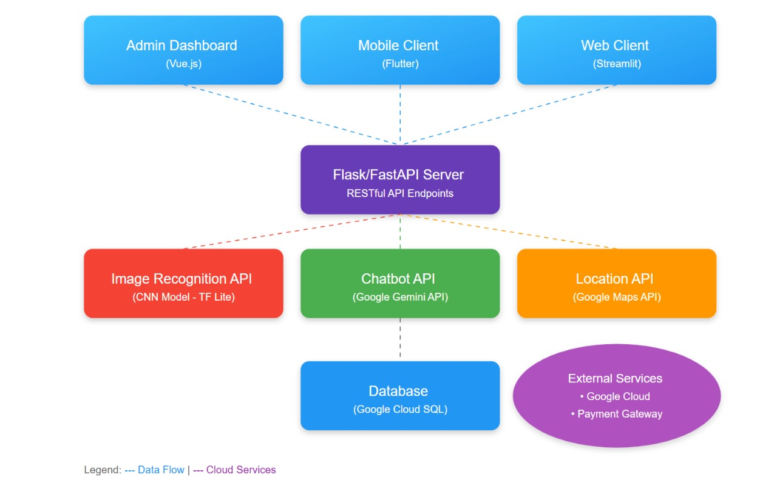
Architecture diagram of the proposed solution

Slide 8
Database & Cloud Backend ✅ FastAPI Backend Framework ✅ Firebase Firestore ✅ Firebase Auth with Google Sign-In ✅ Google Cloud Platform (GCP) for authentication
📱 Mobile App Frontend ✅ Flutter (Dart) for seamless cross-platform UI ✅ Figma for intuitive UI/UX design ✅ IDX Deployment for cloud-based development & testing
AI-Powered Image Recognition - CNN Model FastAPI Deployment for cloud-based API access TensorFlow Lite for mobile optimization Kaggle E-Waste Dataset
Rewards & Gamification Firebase
Firestore Leaderboard & Points System Stripe API for cashback incentives FCM Push Notifications to engage users
Why This Tech Stack?
🚀 AI-Driven 🌍 Cloud-Powered 📈 Scalable & Cost-Effective using Firebase and GCP 📲 Mobile-Optimized
Geolocation & Mapping Google Maps API to find nearby facilities Geolocation API for personalized disposal recommendations
✨ Smart AI Assistance ✅ Google Gemini API for enhanced AI insights & material identification ✅ AI Chatbot using Gemini API for real-time guidance

Slide 9
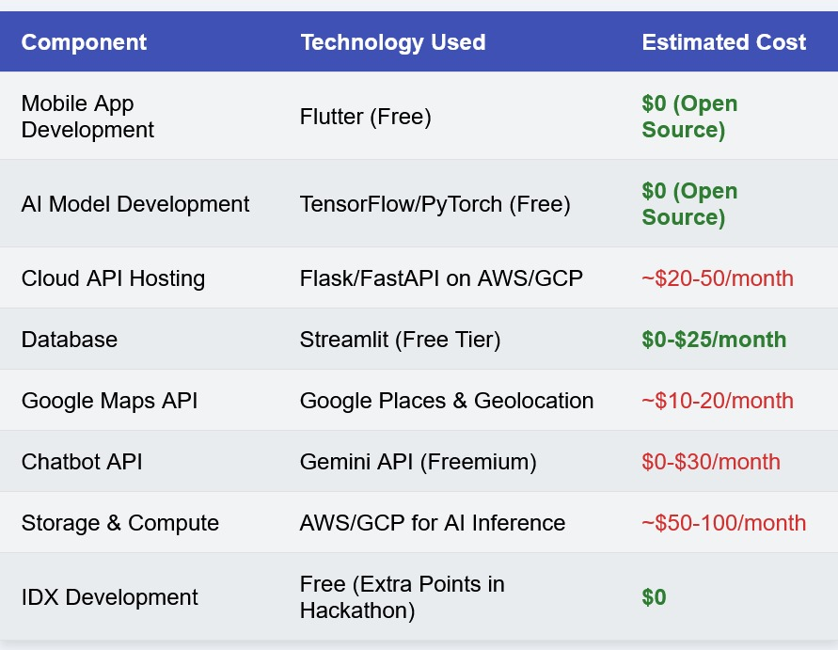
Estimated implementation cost (optional) Additional Details/Future Development
AI-Powered Smart Bins – Use IoT sensors
Real-Time Waste Monitoring – Deploy
IoT-based tracking
Toxicity Detection – Integrate chemical
sensors
Material Analysis – Estimate waste
composition for recyclers

Slide 10
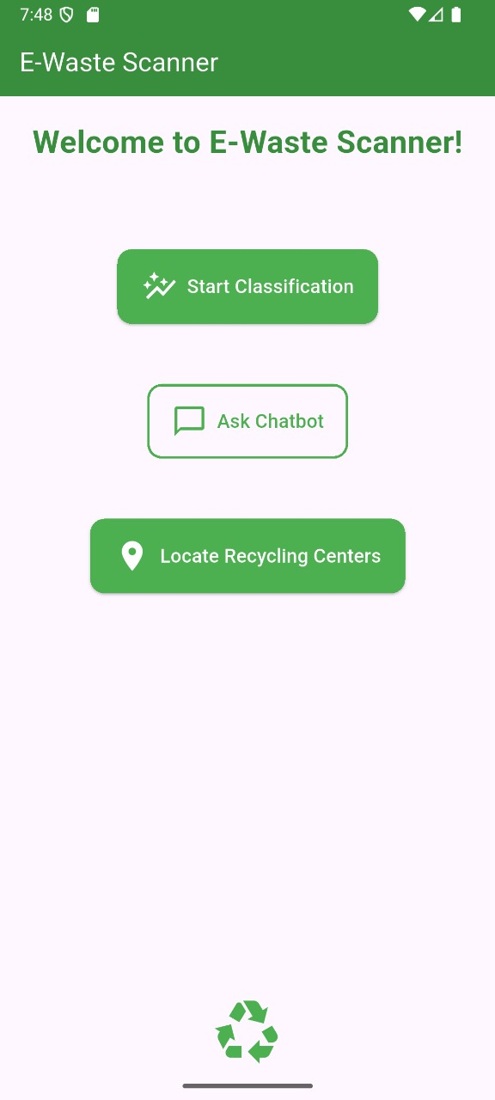
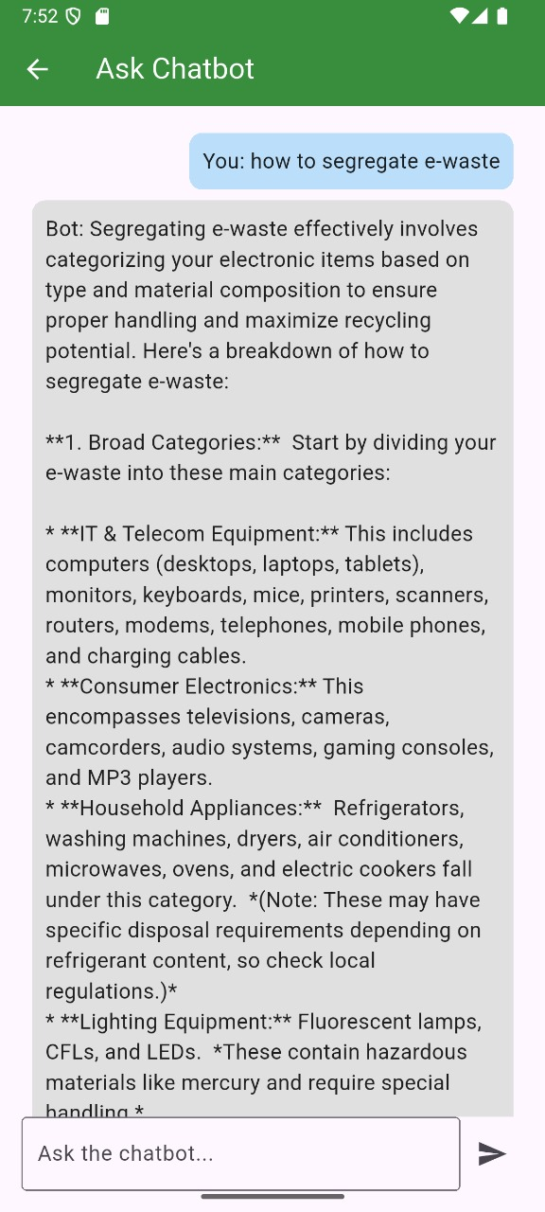
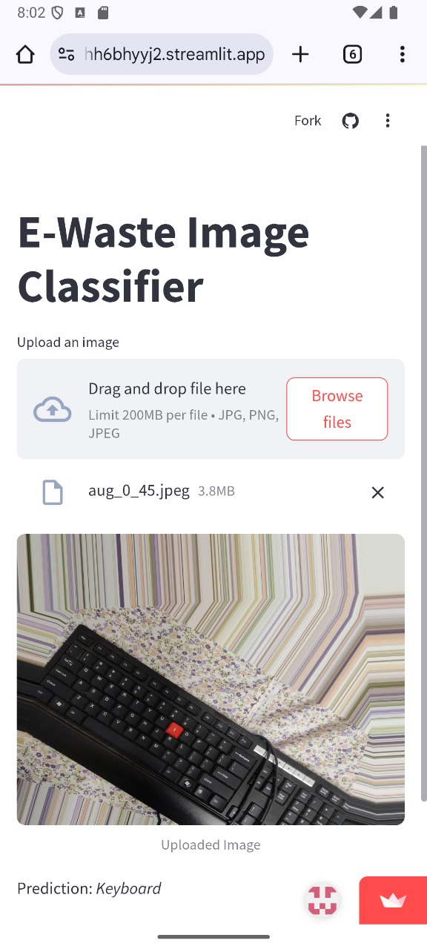
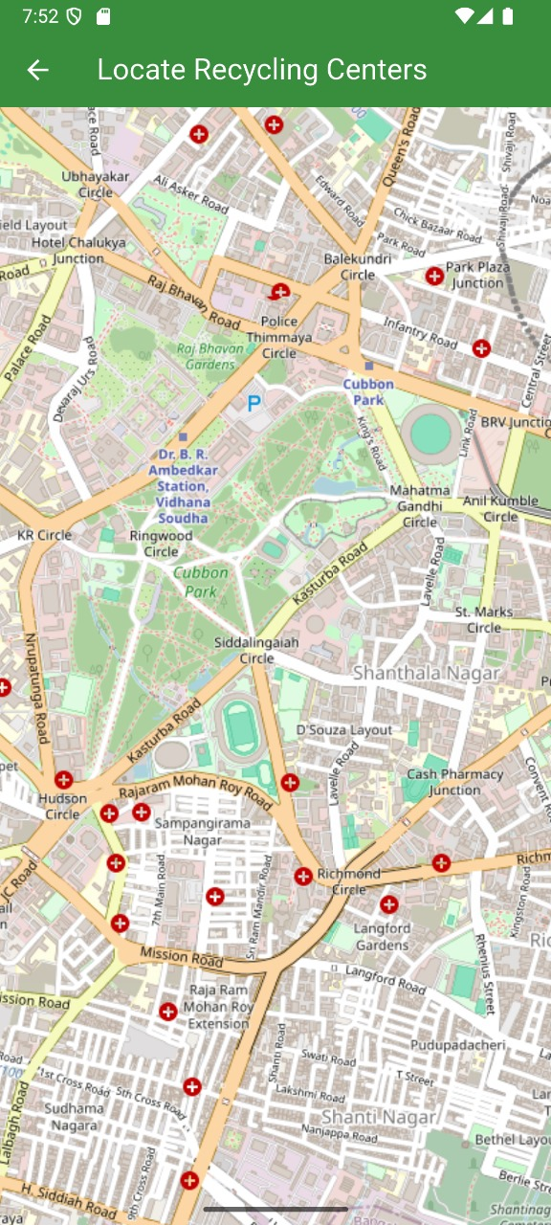
Snapshots of the MVP

Slide 11
Provide links to your:
GitHub Public Repository
Demo Video Link (3 Minutes)
MVP Link

Slide 12


